Slide 1
WELCOME, STUDENTS!
Laci Cedeño, M.S. Ed.
AICE General Paper Teacher, Room 757
South Broward High School

Slide 2
Stay Connected!
For class materials and updates:
Create a school-appropriate Gmail account (if you don’t already have one)
Go to www.lcedeno.weebly.com
Complete the Student Information Form
Sign up for texts through Remind
9th: text @mrsced to 81010
10th: text @mrscedeo to 81010

Slide 3
LETTER TO MYSELF
Respond to the questions below honestly. When you are finished, place your letter in the envelope provided and seal it. Be sure to put your first and last name, as well as the period on the front of the envelope. At the end of the year, I will give the letter back to you.
1. What do you hope to learn in this class? What do you hope to achieve as a part of having this class?
2. What are your goals for school in general this year? How do you plan to achieve these goals?
3. What are some goals you have outside of school? How do you plan to achieve these goals?
4. If you could dedicate all of your future achievements to one person, who would it be? Why?

Slide 4
Technology in the Classroom
Vocabulary will be distributed, practiced, and evaluated using www.vocabulary.com
Grammar will be practiced and evaluated using www.noredink.com

Slide 5
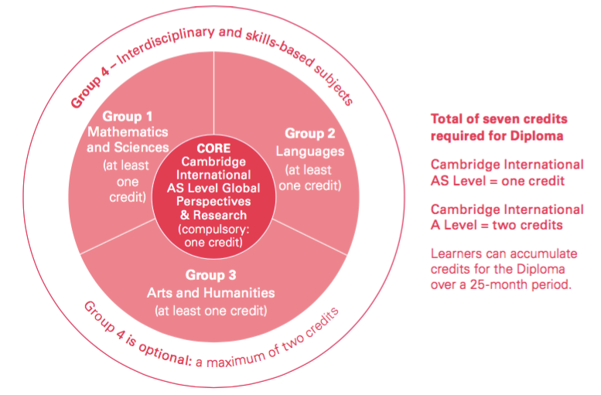
What is AICE General Paper?
Accelerated method of academic study through the University of Cambridge
Broad balance of Math and Science, Languages, and Arts & Humanities
Earn an International Diploma
Total of 7 credits required
Guarantees a Full Bright Futures Academic Scholarship

Slide 6
Syllabus Scavenger Hunt
1. What six supplies are required for this course?
2. What two exams are used to measure mastery of this course’s curriculum?
3. If you are absent, what method should be used to get missed work?
4. How many days do you have to make up work? What if it is a pre-posted test or assignment?
5. What two things are you responsible for in terms of assignments?
6. Where should your phones be kept during class time?
7. What are some examples of a formative assessment?
8. Give several examples of a summative assessment. What weight will be given to summative assessments? Why are these weighted differently?
9. What happens if you are caught cheating or plagiarizing?
10. What is the restroom policy?

Slide 7
What does the exam look like?
Which two prompts would you choose?

